Slide 1
Environmental disclosures
Requirements 6.1 and 6.4
24 June 2020

Slide 2
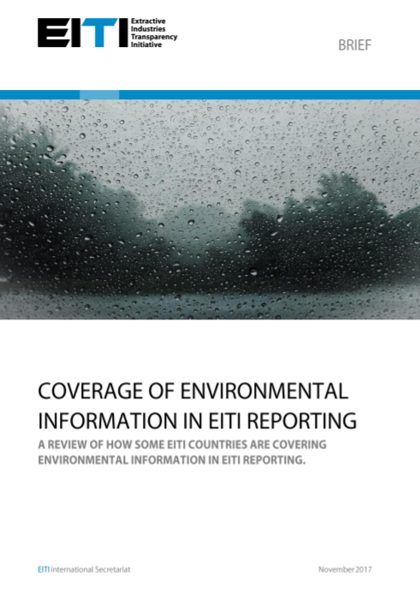
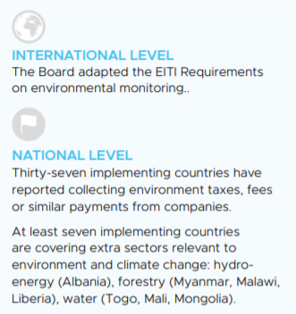
Background or «how did we get here»?
Demand driven – requested by all constituencies, many MSG members with environmental focus, high on our partners’ agenda
Local impact – environmental aspect
Compilation of good practices (briefs)

Slide 3
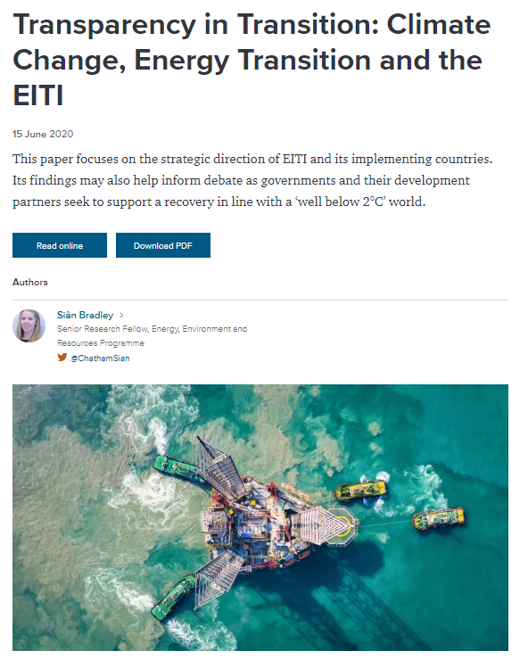
Environmental reporting vs climate change

Slide 4
Requirement 6.1
6.1 Social and environmental expenditures by extractive companies.
… b) Where material payments by companies to the government related to the environment are mandated by law, regulation or contract that governs the extractive investment, such payments must be disclosed.
c) The multi-stakeholder group is required to agree a procedure to address data quality and assurance of information on social and environmental expenditures, in accordance with Requirement 4.9.
d) Where the multi-stakeholder group agrees that discretionary social and environmental expenditures and transfers are material, the multi-stakeholder group is encouraged to develop a reporting process with a view to achieving transparency commensurate with the disclosure of other payments and revenues. The multi-stakeholder group is encouraged to agree a procedure to address data quality and assurance of the information set out above, in accordance with Requirement 4.9.
Step 1: Are environmental payments material?
Step 2: Are environmental payments mandatory?
Material + mandatory = required to be disclosed
Material + discretionary = encouraged to be disclosed

Slide 5
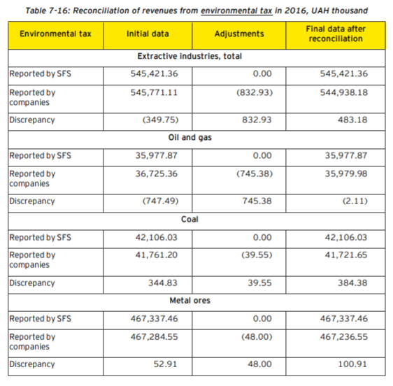
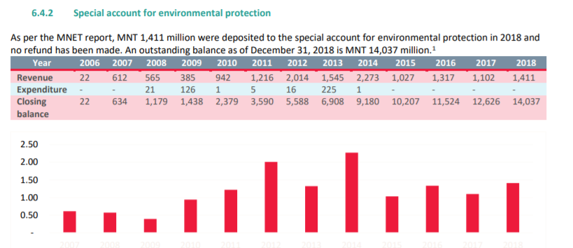
What is already disclosed?
Many countries are already reporting on Requirement 6.1
Environmental fee/tax
Payment for CO₂ and NO_{x} emissions
Payment for air pollution
Payment for emissions to environment
Mine rehabilitation fee
Mine waste fees
Water use fees
Contribution/payment to environmental protection agency/fund
Payment for environmental license/permit
Abandoned mine land fee, fee for forestry use and firewood, etc.
2016 Ukraine EITI Report, p.220 (MSG decided to reconcile environmental taxes even though they were below materiality threshold)
2018 Mongolia EITI Report and summary data file (approximately 3% of total revenues from the EI)

Slide 6
#6.4: What was introduced in Paris?
Brand new Requirement 6.4 , opportunity (=encouraged) to disclose information on
Management of environmental impact:
Legal provisions and administrative rules
Agencies responsible for management (roles, responsibilities)
Instruments: EIAs, certifications, environmental licenses, environmental rights
Actual practice and reforms underway
Monitoring of environmental impact:
Legal provisions and administrative rules
Monitoring agencies and procedures
Instruments: sanctions, liabilities, remediation and rehabilitation programmes
Actual practice and reforms underway
Some information is already available under requirements 2 and 5
6.4 Environmental impact of extractive activities.
Implementing countries are encouraged to disclose information on the management and monitoring of the environmental impact of the extractive industries. This could include:
a. An overview of relevant legal provisions and administrative rules as well as actual practice related to environmental management and monitoring of extractive investments in the country. This could include information on environmental impact assessments, certification schemes, licenses and rights granted to oil, gas and mining companies, as well as information on the roles and responsibilities of relevant government agencies in implementing the rules and regulations. It could further include information on any reforms that are planned or underway.
b. Information on regular environmental monitoring procedures, administrative and sanctioning processes of governments, as well as environmental liabilities, environmental rehabilitation and remediation programmes.

Slide 7
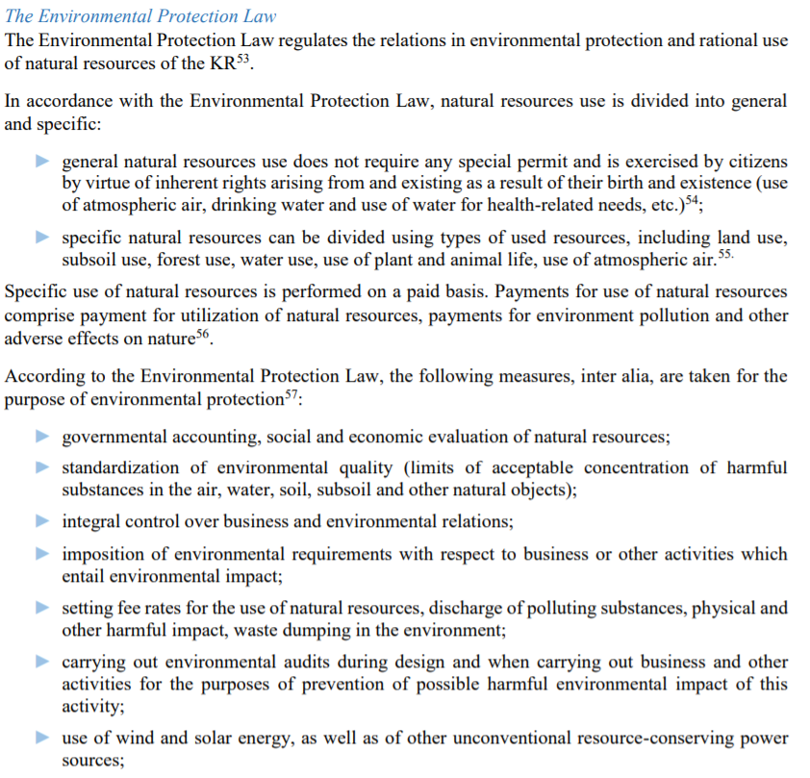
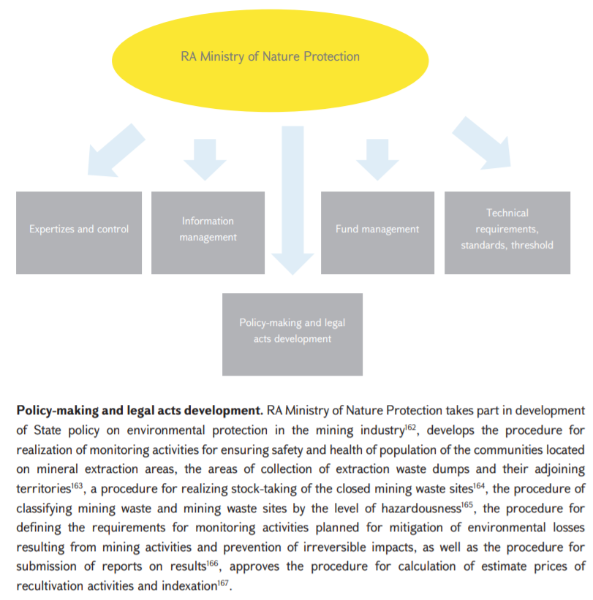
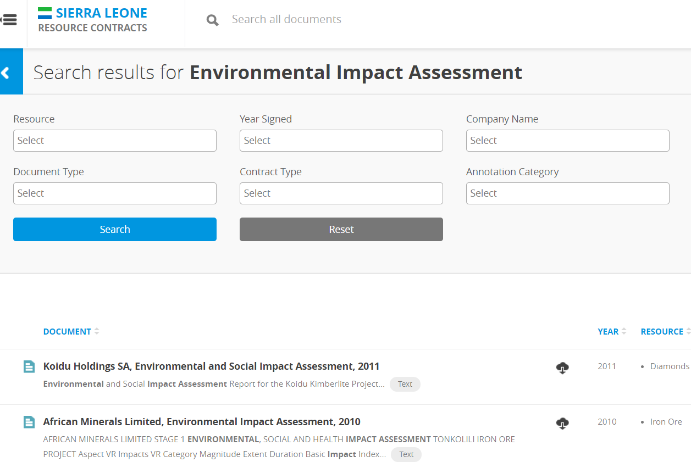
What is already disclosed?
Requirement 6.4 - Management of environmental impact:
Legal provisions and administrative rules
Agencies responsible for management (roles, responsibilities)
Instruments: EIAs, certifications, environmental licenses, environmental right
2015-2017 Kyrgyz Republic EITI Report, p.25 (relevant legal provisions)
2016-2017 Armenia EITI Report, p.124 (description of relevant government agencies and their responsibilities)
SL: online platform (Resource Contracts) administrated by the National Minerals Agency where EIAs for 2010-2014 are available (mining sector)

Slide 8
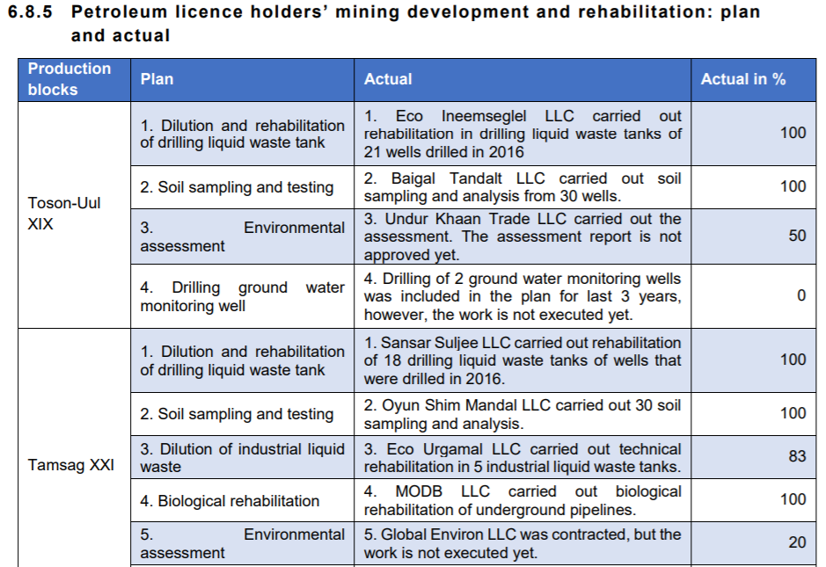
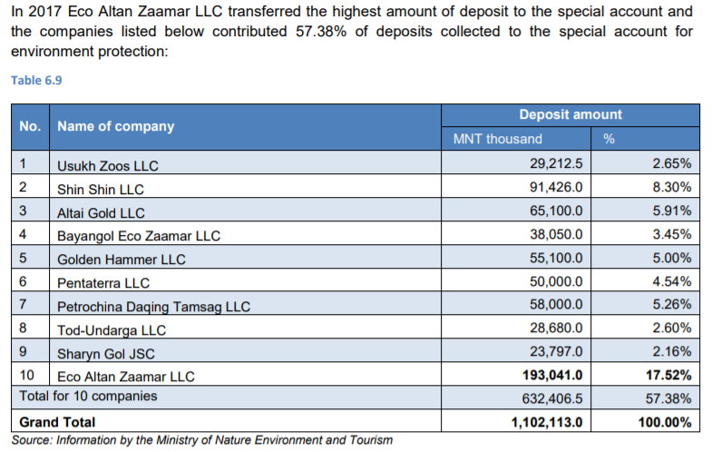
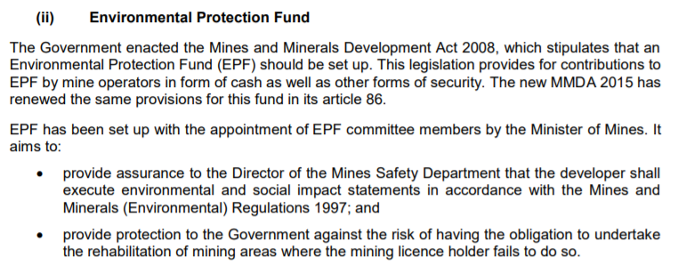
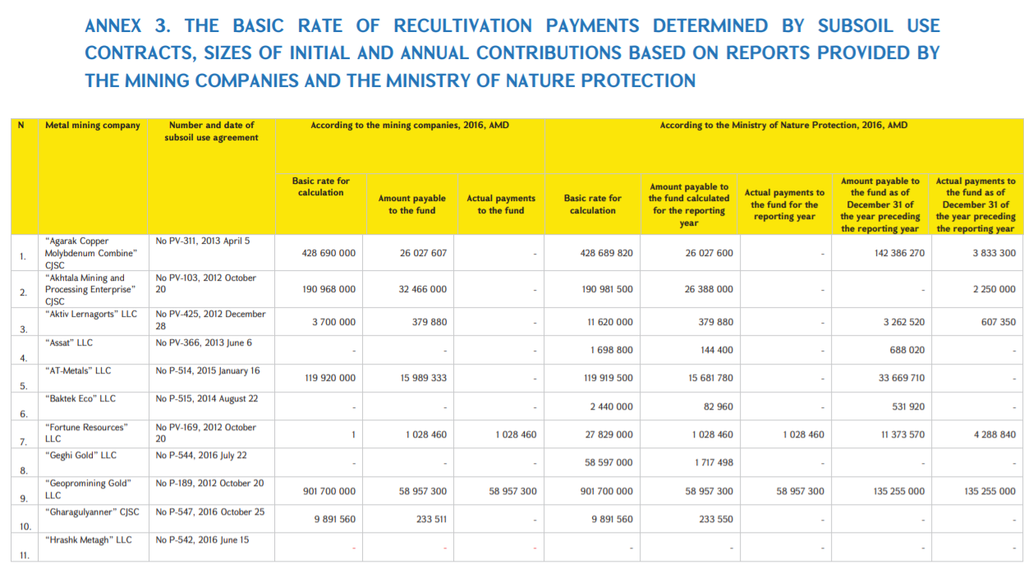
What is already disclosed?
Requirement 6.4 - Monitoring of regulations
Monitoring agencies and administrative aspects
Sanctions
Liabilities
Rehabilitation
Remediation
2017 Mongolia EITI Report, pp.134-135
2016 Zambia EITI Report, p.37 → Monitoring agencies and status of progress
2016-2017 Armenia EITI Report, p.236

Slide 9
Case study: Peru (2015-2016 EITI Report)
Legal provisions (overview)
Relevant agencies (roles and responsibilities)
Certifications
Liabilities
Remediations
Sanctions
Examples of mainstreamed information

Slide 10
Example: Peru 2016 EITI Report Overview legal provisions
Laws and Decrees (general)
Regulations and decrees (mining)
Laws, regulations, decrees (oil and gas)
Sources

Slide 11
Peru 2016 Report (legal provisions cont.)
Summary explanation of each Law,
Decree and Regulation (norm)

Slide 12
Peru 2016 Report (relevant government agencies)

Slide 13
Peru 2016 Report (Roles and responsibilities of relevant agencies)
Example
SENACE (National certification
System) approves EIAs

Slide 14
Peru 2016 – Certifications (mainstreamed in SENACE website)
Online consultation
(geo-referenced)
in
SENACE’s website
of environmental
certifications

Slide 15
Peru 2016 Report Liabilities and remediations
Liabilities oil and gas
Liabilities mining
Remediation (Contingency fund)

Slide 16
Peru 2016 Report– Sanctions
Sanctions
Summary of sanctions imposed by OEFA
Summary of sanctions imposed by environmental court

Slide 17
Peru 2016 Report– Links to relevant info (mainstreaming)

Slide 18
Other examples in LAC - Colombia
For example, Colombia includes environmental follow-up in its portal (EITI Reports 2016 and 2017) infographics to explain how to request environmental licenses, among other information (contextual).

Slide 19
Other examples in LAC - Mexico
Mexico conducted a scoping study on social and environmental disclosures
Includes information on
Norms (on use of land, water, residuals, protected areas)
Environmental permits
Remediation Funds
among others.
Plus: recommendations on what to include in EITI Reports

Slide 20
Other examples in LAC - Mexico
The study also compared how mining companies were complying with the GRI Standard for Sustainability reports:
GRI categories of reporting:
Water
Biodiversity
Efficiency
Emissions
Residuals
Environmental expenditures and
investme
Sustainability reports available per Mining (EITI) reporting company
Assessment of how many GRI Indicators selected companies reported

